Slide 1




C5 participant feedback
PHASE 2 FINAL SURVEY

Slide 2



MOST SIGNIFICANT CHANGE
Describe the most significant change this month-long course has had on you.
Self-confidence
Technical Skills
Soft Skills
This included things like:
Leadership
Renewed sense of purpose
Speaking English
Creativity
Shift in teaching style
This included things like:
Lesson planning
CARE
Experiential Learning Cycle
Giving and receiving feedback
This included things like:
Perception shift
Rethinking teaching philosophy
Connecting with others
Breaking down stereotypes
Collaboration

Slide 3
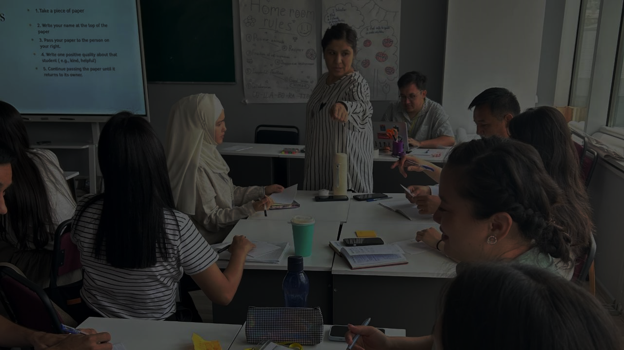
INCREASE IN SELF-CONFIDENCE
LEADERSHIP
The most significant change this course has had on me is a boost in my self-confidence as an English language educator. I have not only improved my communication and presentation skills, but I have also started to think more critically and creatively about teaching. Now I feel more capable of leading, sharing ideas, and making a real impact in my community.
SENSE OF PURPOSE
SPEAKING ENGLISH
The most significant change this month-long course has had on me is in my mindset and confidence as a teacher. I’ve learned to see challenges as opportunities to grow, and I now feel more open to trying new methods in my classroom. I’ve become more reflective, more creative in planning lessons, and more connected to other educators. This course helped me believe that small changes can lead to meaningful impact, and I feel ready to support my students better than before.
CREATIVITY
INTENTIONALITY

Slide 4
INCREASE IN SELF-CONFIDENCE
LEADERSHIP
I feel more equipped with new skills and knowledge to enhance my teaching practices. I also experience a boost in confidence and a renewed sense of purpose in my profession. Thanks a lot for this great opportunity! I really appreciate it.
SENSE OF PURPOSE
SPEAKING ENGLISH
It boosted my love to my job. I started to proud of myself being a teacher.
CREATIVITY
I feel that now I am more effective as a teacher and I am inspired by my peers and trainers to revolutionise education system in my country and beyond.
TECHING STYLE SHIFT

Slide 5
INCREASE IN SELF-CONFIDENCE
The most significant change this month-long course has had on me is increased confidence in using English in real-life situations. Before the course, I was often hesitant to speak, afraid of making mistakes. However, through daily speaking tasks, group activities, and supportive feedback, I’ve learned that communication is more important than perfection. Now, I feel more comfortable expressing my ideas and asking questions in English, even if I make small errors. This change has not only improved my language skills but also boosted my self-esteem.
LEADERSHIP
SENSE OF PURPOSE
SPEAKING ENGLISH
The most significant change this month-long course has had on me is the improvement in my confidence when speaking English. Before the course, I was often shy and afraid of making mistakes. But during the lessons, I had many chances to speak, work in groups, and share my ideas. Now, I feel much more comfortable expressing myself. I also learned how to organize my thoughts better and use a wider range of vocabulary. This experience helped me grow both personally and academically.
CREATIVITY
TECHING STYLE SHIFT

Slide 6
INCREASE IN SELF-CONFIDENCE
LEADERSHIP
The most significant changes I experienced during the program were in my confidence and teaching mindset. I moved from relying heavily on traditional methods to embracing more interactive, student-centered approaches. I began seeing my students not just as learners of grammar and vocabulary, but as communicators and critical thinkers. I also became more reflective and intentional in my teaching choices. This shift will make my lessons more meaningful, and I will see real progress in both my students and myself.
SENSE OF PURPOSE
SPEAKING ENGLISH
CREATIVITY
I’m more confident and professional now. I can change my classes from traditional way of teaching to the student-centred way. Moreover, I have a lot of friends from around the globe.
TECHING STYLE SHIFT

Slide 7
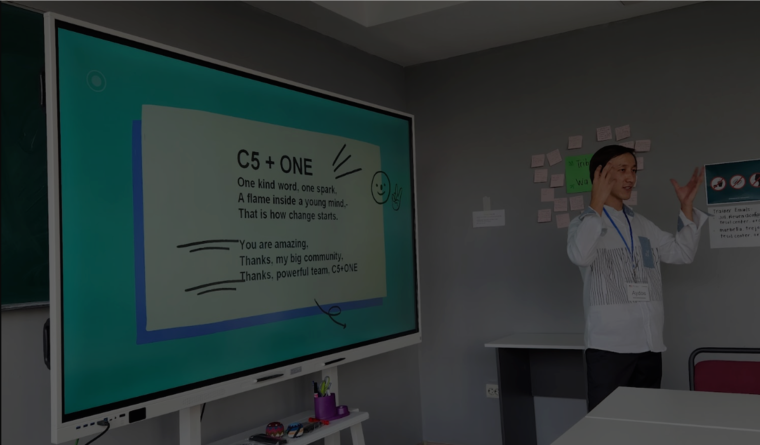
TECHNICAL SKILLS
I've learned how to give feedbacks better and in a more professional way. Additionally, trainers taught us a lot how to adapt our lesson plans and use differentiation. Yet, more importantly, they taught us that connection isn’t always about shared culture or beliefe, sometimes, it’s just about being human together.
I have had the greatest knowledge and experience in this program and had not had such a profound insight before. I learned a lot about scaffolding, differentiation, ICQs and CCQs, and CLT and other significant things that I cannot end counting with. I have changed into an absolutely different teacher to implement interactive activities into my classroom and be flexible with mixed-ability students.
Now I am more confident in designing and delivering PD sessions. I have many plans ahead.

Slide 8
TECHNICAL SKILLS
The significant change was the development of my abilities as a teacher. I gained a lot of knowledge about my profession, and for me, as a young teacher it was a wonderful experience to work with teachers from Central Asia countries. And I’m pretty sure that I will share my knowledge to my colleagues, regional teachers and of course, my students.
As a young teacher, all the information that we got was incredibly useful for me. After having this course I learned more about my teaching where I had mistakes, about lesson planning, CARE method, learning cycle, giving clear instructions, setting clear objectives, working as a team. The another thing that I really enjoyed is teacher’s collaboration from different countries, their engagement and sharing experiences.

Slide 9
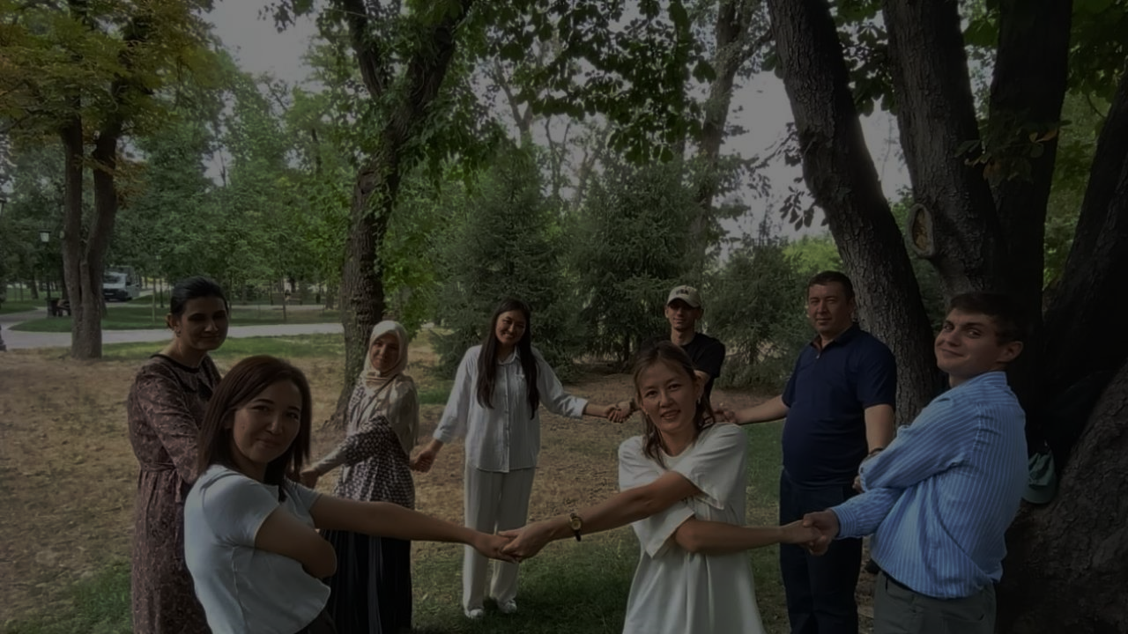
SOFT SKILLS
The most significant change was the stereotypes about other countries which were broken throughout the programme.
The most significant change this month-long training has had on me is a deep transformation in how I view my role as an English teacher—from someone who simply delivers lessons to someone who designs meaningful, learner-centered experiences. This training helped me rethink my teaching philosophy, incorporate more reflective and interactive approaches, and build stronger connections between theory and classroom practice. I now feel more empowered to implement innovative methods, collaborate with peers, and continuously grow both professionally and personally.
The most significant change this course has had on me is the improvement of my communication and collaboration skills. I became more confident in sharing my ideas in English, and I realized how powerful teamwork can be when people from different backgrounds come together.
The most significant change is the time l truly connected with other participants during microteaching, group working, where we were sharing our ideas, working collaboratively, laughing and learning from each other. The instructions were really brilliant and professional.

Slide 10
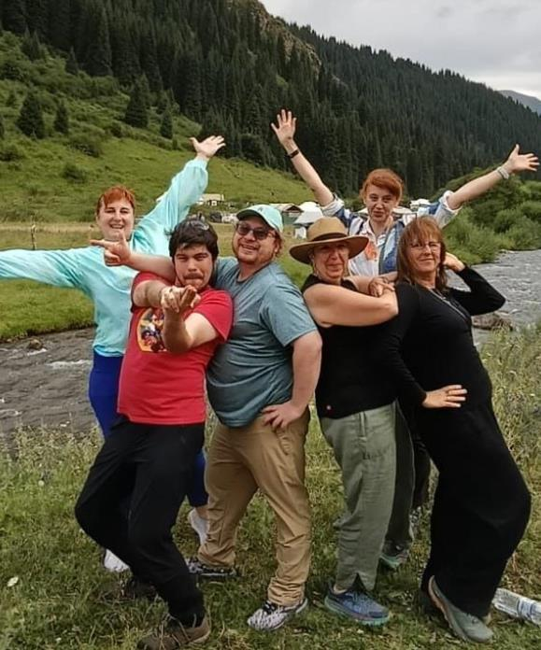
RATINGS
Trainers
English Clubs
4.96
4.82
Almaty curriculum & programming
4.92
“
I’m deeply grateful to my instructors for their passion, patience, and encouragement. Their dedication made learning not just easier, but truly enjoyable. They didn’t just teach—they inspired confidence and helped me find my voice in teaching.

Slide 11
Mid-point survey
LEVELS & COMPARISONS
Final survey
*These percentages only include the topmost level (“A great deal” from the mid-point survey and “A major impact” from the final survey)
90.7
86.4
84.6
81.4
75.8
69.8
69.1
72.1
65.7
63.8
Impact on teaching
Improved English
Ability to scaffold
Managing mixed-ability classes
Giving feedback
Impact of PELP
Impact of micro-teaching
Impact on planning/ delivering PD activities
Notes:
Impact on teaching: 84.6 to 90.7
English improvement: 69.8 to 65.7
Ability to scaffold: 75.8 (MP)
Managing mixed ability classrooms: 63.8 (MP)
Giving feedback: 69.1 (MP)
Impact of PELP: 81.4 (F)
Impact of MT on teaching: 86.4 (F)
Impact on planning & delivering PD activities: 72.1 (F)

Slide 12
Phase 1 Final survey
LEVELS & COMPARISONS
Phase 2 Final survey
Check all areas where you have more knowledge and/or confidence since May 13 / July 9
91.4
89.3
87.5
81.4
81.4
77.1
72.8
70.7
62.1
61.5
64.9
65.5
56.4
57.9
56.4
51.9
46.3
40.1
CLT
Giving clear instructions
Adapting textbook activities
PBL
Teaching ESP
Using authentic materials
Assessing learning
Supporting mixed-abilities
Scaffolding
Notes:
Final survey:
CLT - 91.4
Giving clear instructions – 89.3
Adapting textbook activities (CARE, etc.) – 77.1
PBL – 56.4
Teaching ESP – 81.4
Using authentic materials – 62.1
Assessing students’ learning – 57.9
Supporting different levels – 70.7
Scaffolding – 81.4
Helping Ss become ind’t learners – 67.1
Improving English – 81.4
Using ed tech – 62.9
Using AI – 57.1
Responding to language errors – 58.6
Planning PD activities – 75

Slide 13
Phase 1 Final survey
LEVELS & COMPARISONS
CONT.
Phase 2 Final survey
Check all areas where you have more knowledge and/or confidence since May 13 / July 9
81.4
78.5
75
67.1
65.5
58.7
57.1
57.1
58.6
41.8
32.2
37.2
Helping Ss be ind. learners
Improved English
Using ed tech
Using
AI
Responding to errors
Planning PD activities
Notes:
Final survey:
CLT - 91.4
Giving clear instructions – 89.3
Adapting textbook activities (CARE, etc.) – 77.1
PBL – 56.4
Teaching ESP – 81.4
Using authentic materials – 62.1
Assessing students’ learning – 57.9
Supporting different levels – 70.7
Scaffolding – 81.4
Helping Ss become ind’t learners – 67.1
Improving English – 81.4
Using ed tech – 62.9
Using AI – 57.1
Responding to language errors – 58.6
Planning PD activities – 75

Slide 14
LOGISTICS RATINGS
Travel arrangements/ transport
Weekend support
Accommodations
Meals
4.59
3.6
4.18
4.35
“
Overall, the logistics were well-managed, and I truly appreciate the efforts KazTEA made to ensure our comfort and safety. The travel arrangements were smooth and well-coordinated, and the per diems were helpful and provided on time. Accommodation was comfortable and located conveniently. Meals were generally good, though a bit more variety—especially for those with dietary restrictions—would be appreciated in the future. Thank you to the entire KazTEA team for your hard work behind the scenes!

Slide 15
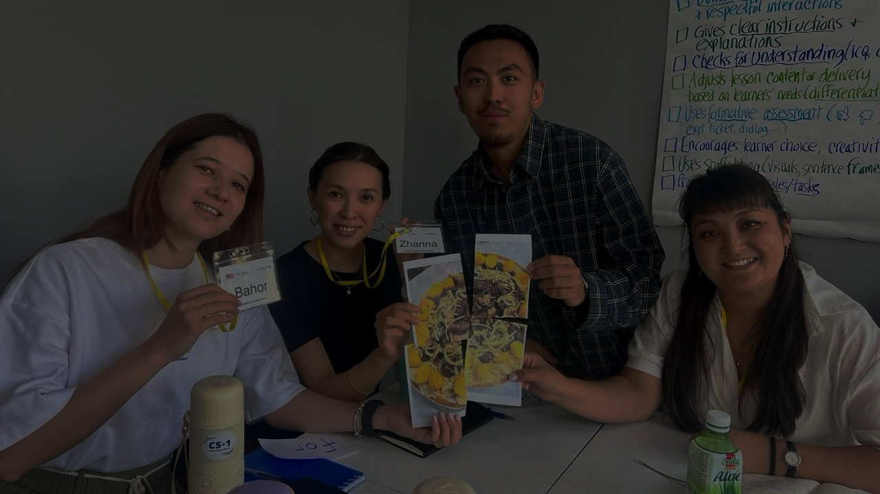
LOGISTICS FEEDBACK
In general, the constructive feedback addressed the following three areas. The top bolded bullet point was the most mentioned. But also, most of the feedback was very positive and the participants expressed many thanks and gratitude (even when providing the constructive feedback).
MEALS
ACCOMMODATIONS
PER DIEM
General preferences/ dietary restrictions not considered
Needed more variety (esp to incl dietary restrictions)
Meals too spicy and/or sweet
Horse meat was a problem
No air conditioning
Wifi issues
Far from the university
Insufficient refrigerator space for so many people
Laundry access issues
Beds were a bit too short
Bed bugs
Bathroom mold
Confusion about per diem amount and less than expected
Could have been distributed sooner

