Slide 1
Languages in Scotland: 1+2
Robert Sim, e3Net Consultancy
KazTEA Conference, 30 March 2017
Notes:
Personal background - 35 years in Scottish education - 20 as English teacher and 15 as education officer/adviser for an area - an oblast. I will tell you more about that area later. Now working independently and also through the e3net consultancy. Looking forward to returning to KZ in the summer.

Slide 2
Map of United Kingdom
Notes:
Here is a map of the UK. Made up of four nations or areas. List and explain.

Slide 3
Map of Scotland
Notes:
More detailed map of Scotland. Mountainous area in the north. Many islands and meandering coastline. Point to Shetland Islands ad explain that is my home and workplace for 35 years.

Slide 4
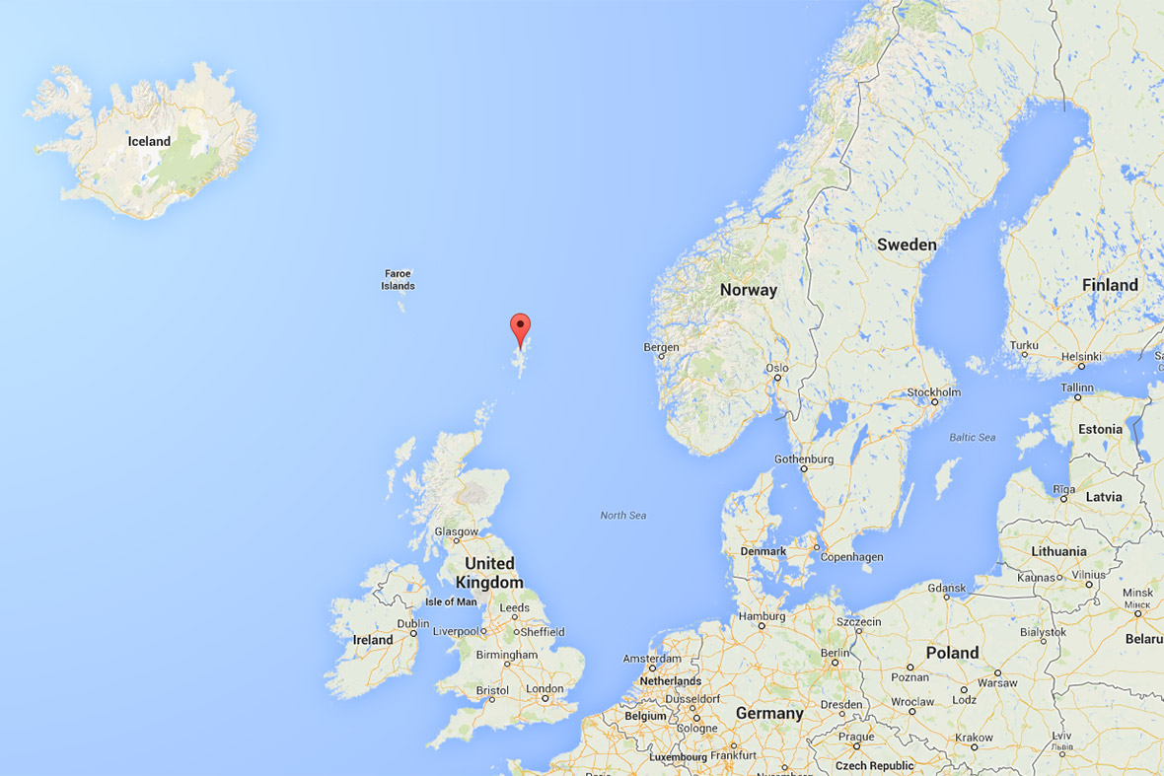
The Shetland Islands
Notes:
Location of Shetland in relation to the continent – crossroads of sea highways. Big Norse influence. Linguistic mix of Scots, Norse and English.

Slide 5
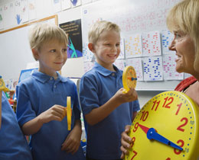
1+2 Approach to Language Learning
Scottish Government Manifesto 2011
Language learning to become the norm in Scottish Primary Schools
Based on European Union Model
Delivered by class teacher as part of the normal curriculum
Priority nationally, in each district and in each school. School management lead it.
Notes:
Explain. Previous MLPS model and secondary specialists coming in for discrete blocks.

Slide 6
Background to the 1+2 Approach: What is 1+2 ?
Mother tongue = L1
All children in Scotland access a modern language from P1 (5 years old) = L2
All children have exposure to another modern language no later than P5 (9 years old) = L3
Phased approach 2014 - 2020
Notes:
Explain the langauges.

Slide 7
What is the reasoning behind this?

Slide 8
Why should a child in Scotland learn other languages?
More than 75% of the world’s population does not speak English.
Language learning deepens our awareness of other cultures.
Equips our children with skills for the workplace.
Strengthens knowledge and improves literacy in the mother tongue.

Slide 9
When will a child in Scotland start learning another language?
By 2020 all Scottish primary school children will learn a second language from P1-S3 (5-15 years old).
It is expected there will be the opportunity to sit a national qualification in the second language.
Third language no later than P5 (9 years old)

Slide 10
Dr Alasdair Allan, Minister for Learning, Science and Scotland’s Languages
The Scottish Government view
Notes:
Up to 2.51

Slide 11
Languages typically studied in Scottish schools
L2 = French, German, Spanish and Gaelic (the latter usually in a Gaelic-medium school)
L3 = The above plus Italian or Mandarin. This is not an exhaustive list. See the SQA site.

Slide 12
Transition to S1
S1= first year of secondary (12 years old)
In most cases, a student will continue studying L2 until the end of S3 (15 years old).
The P7 profile will inform S1 language learning.
L3 will be offered as an additional choice from S1-3.

Slide 13
When mother tongue is not English, what does 1+2 mean?
Mother tongue = L1
English = L2
Other modern language = L3
Mother tongue to be recognised and valued.

Slide 14
Additional Support Needs (ASN) Learners and 1+2
Entitlement to learn another language at a level appropriate to needs.
Support to be given to overcome barriers to learning.
Parents can discuss this on an individual basis with their school.

Slide 15
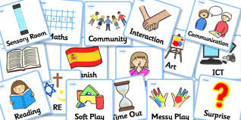
How will language learning fit into the curriculum?
Normal part of the curriculum
Embedded in early stages
Use of language learning in daily classroom routines
Included in other areas of the curriculum eg. Maths, P.E or Topic
Notes:
This is effectively CLIL. CLIL is not seen in Scottish schools in secondary but it is in primary and perhaps this will permeate upwards.

Slide 16
1+2 in practice
Primary school
Notes:
Explain about Scots – pupils speaking it. All 6 mins.

Slide 17
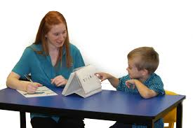
How can a parent support their child?
Positive attitude to languages and other cultures.
Have fun!
Ask their child to teach them what they have learned.
Label household items, look at interesting websites, read cartoons in other languages etc.

Slide 18
Important to have all agencies supporting a languages strategy
Scottish Centre for Languages (SCILT)
‘Mother Tongue, Other Tongue’ poetry competition, with support from Scotland’s national poet, Jackie Kay
2015-16 anthology

Slide 19
Questions or comments?
https://education.gov.scot/improvement/Documents/ModernLanguagesBenchmarksPDF.pdf

Slide 20
Contact Details
Robert Sim
robertdouglassim@gmail.com
e3Net Consultancy
http://e3net.org.uk/

